Slide 1
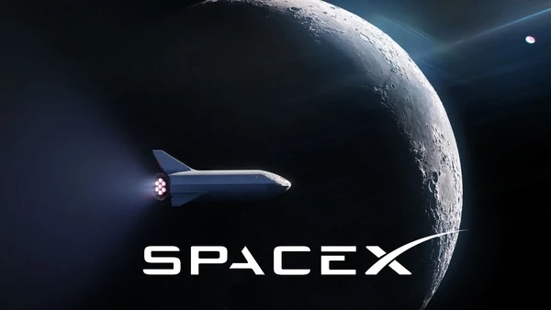
SpaceX
IST 621 - FINAL CASE STUDY
GROUP 7

Slide 2



Background
The Soviet’s launch of Sputnik 1 pushed the establishment of NASA
The space race began to put man on the moon
The US DOD spurred the race for ELVs to carry payloads
The United Launch Alliance became the monopoly for ELV production in the US
NASA launched the COTS Program to subsidize the development of private launch vehicles

Slide 3
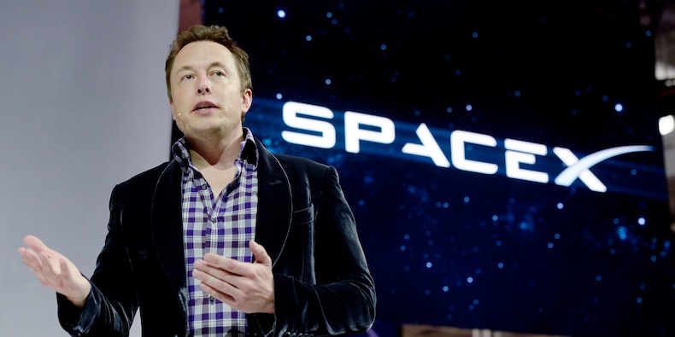
Space Exploration Technologies (SpaceX)
Founded by Elon Musk in 2002 along with Gwynne Shotwell, President and COO of SpaceX.
Musk’s three key suggestions:
Reusability
Reliability without over-engineering
Vertical Integration
Cost savings could be achieved!

Slide 4
SpaceX’s Product Development
Falcon 1
3 failed launches. Merlin 1C engine.
Successfully launched in 2009, an actual payload in Lower Earth Orbit (LEO)
Falcon 9
Used 9 Merlin 1C engines developed and tested for Falcon 1.
Delivered medium to heavy payloads.
More iterations, Falcon 9 v1.0, Falcon 9 v1.1 (upgraded Merlin 1D engine) , Falcon 9 v1.2
Launch Capabilities: 22800 Kg to LEO and 5300 Kg to Geostationary Transfer Orbit (GTO)
Dragon
Dragon 1.0, designed to carry cargo upto 6,000 Kgs.
Dragon Crew, accommodate upto 7 astronauts.
Falcon Heavy
Used 3 cores of Falcon 9’s first stage.
Launch capabilities: 63800 Kg to LEO and 8000 Kg to GTO
Starship
Mars Colonial Transporter/ Interplanetary Transport system.
Capable of carrying 100 metric tons to earth's orbit or 100 people to mars, fully reusable transport system.
Still in development as of 2019

Slide 5
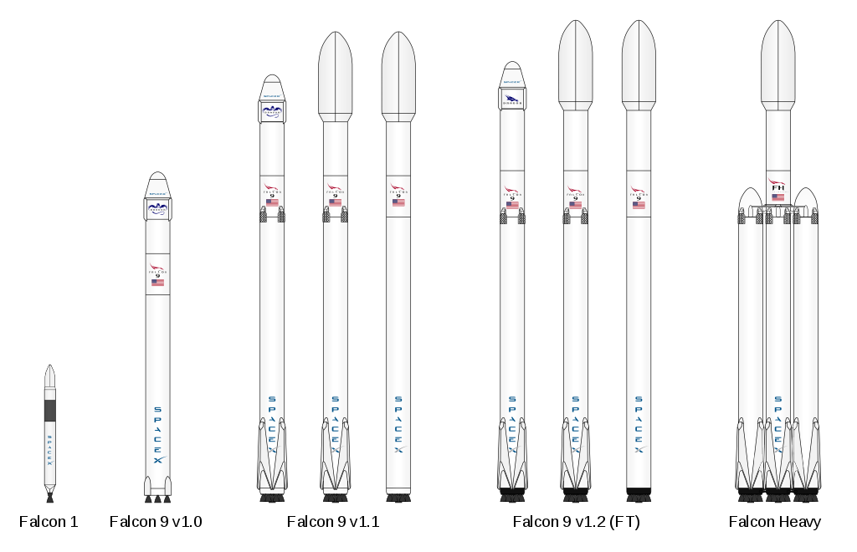
Falcon 1
Falcon 9 V1.0
Falcon 9 V1.1
Falcon 9 V1.2
Falcon Heavy

Slide 6
SpaceX's Success and Economies of Scale
Increased Global Market share from 10% to 60%.
Economies of Scale- The organisations which produced more had the leverage of selling the products for a lower market price which in turn increased the demand.
SpaceX could cut down cost mainly because of :
Using Existing Technologies rather than implementing new one
High Vertical Integration Approaches
Commonalty in work to reduce extra effort
Three Additional Factors :
Intense Work Environment
Organisational Simplicity
Lean Infrastructure

Slide 7
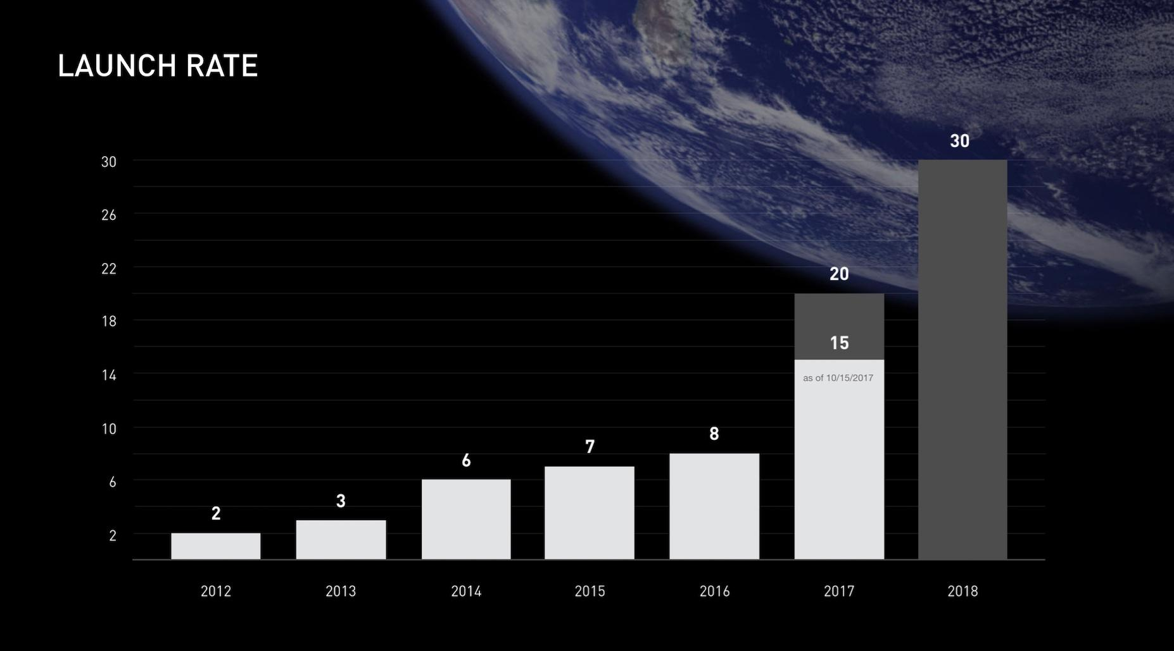

Slide 8
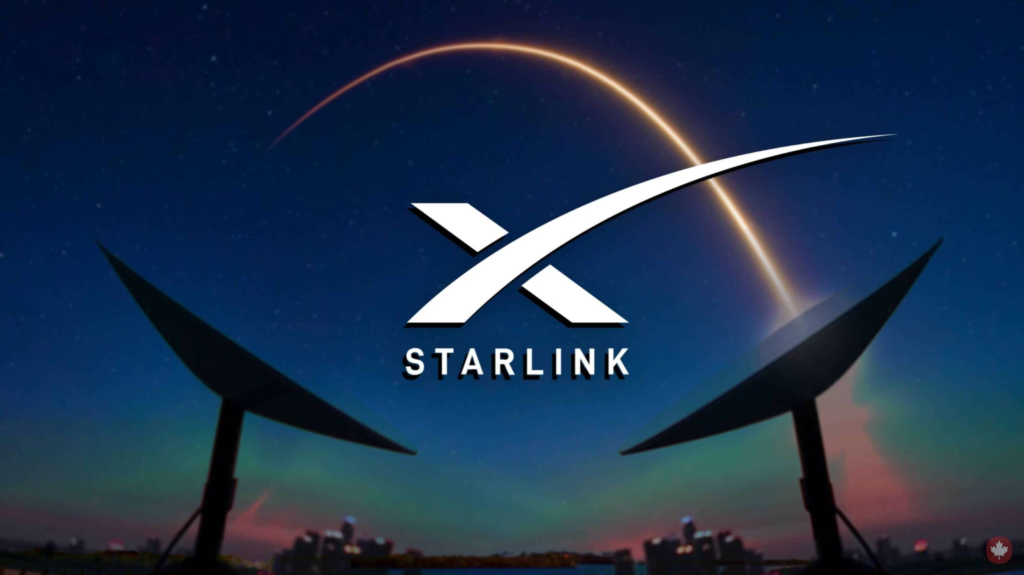
Ultimate Goal and Plan of Action
Develop Starship to reach Mars → $2 - $3 Billion
Use other sources of revenue for Starship
Cost of reaching Mars → $200 Billion
SpaceX’s revenue streams:
Launching satellite
Starlink → global broadband internet
Human transportation → space tourism

Slide 9
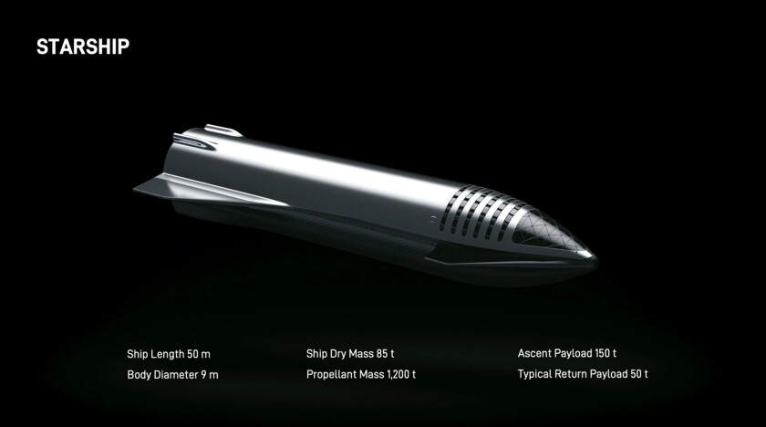
Current and Future Plans
Launch Starship first flight in Jan 2022
Aims to launch dozen Starship flights next year
Launch cargo in Starship by 2023 to get economies of scale
NASA Artemis program to land humans on Moon by 2025
Transport million people to Mars by 2050
Make humans a multiplanetary species

Slide 10
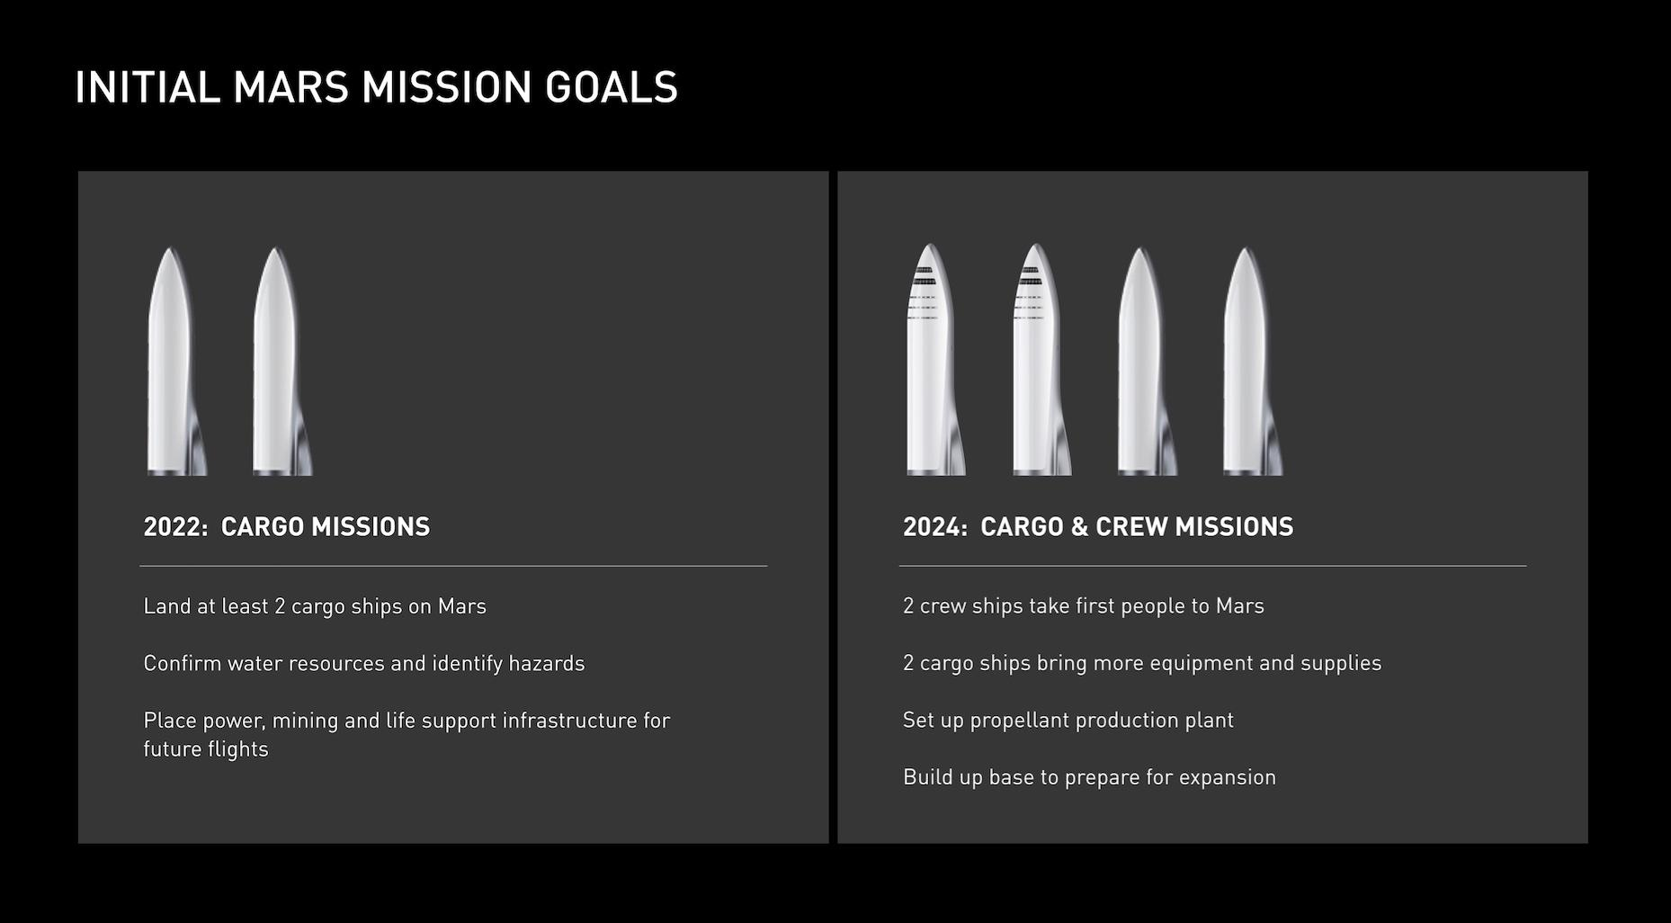

Slide 11
THANK YOU !

